Slide 1

WAY TO ENTERPRISE
Java Basics
VTI ACADEMY
Author: duy.nguyenngoc1@vti.com.vn
March 2020

Slide 2
Agenda
Constructor
Package
Access Modifier
OOP
Assignments
Copyright © VTI Academy All Rights Reserved

Slide 3
Constructor
Purpose: Init Object
Multiple Constructors
Default Constructor: no parameter

Slide 4
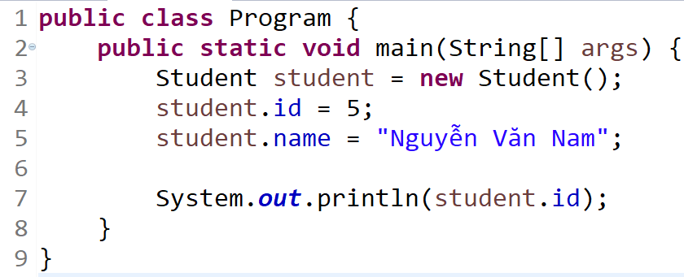
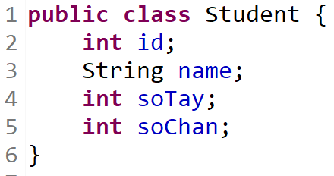
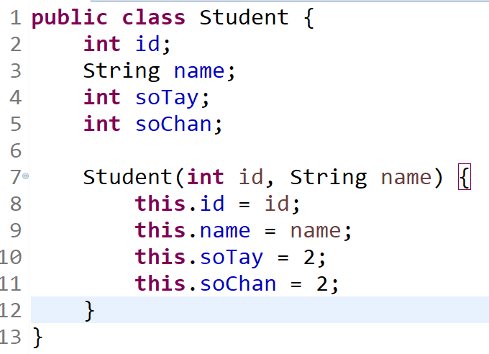
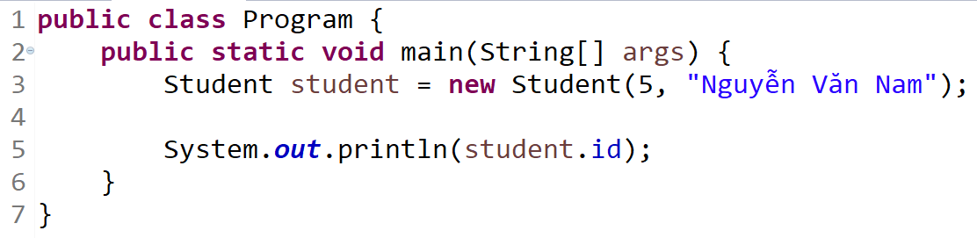
Example

Slide 5
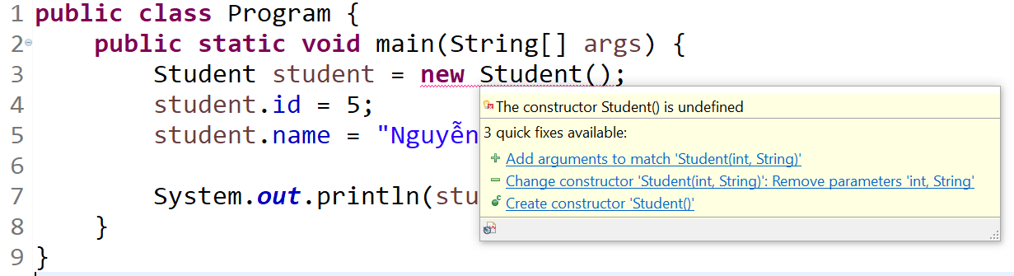
Example

Slide 6
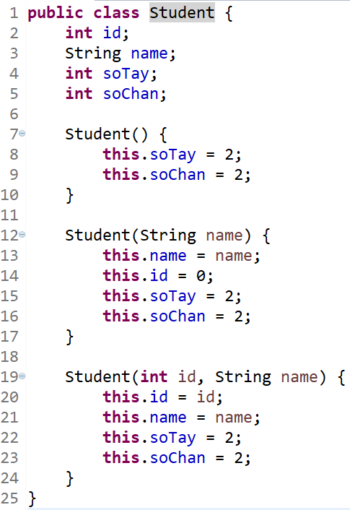
Example

Slide 7
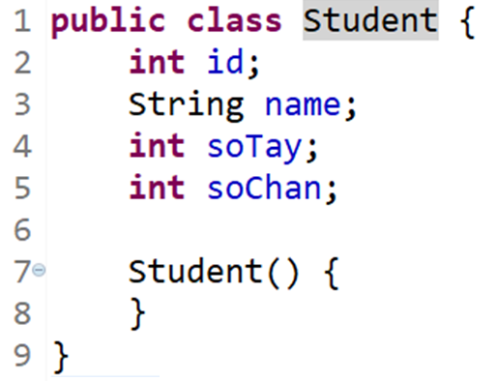
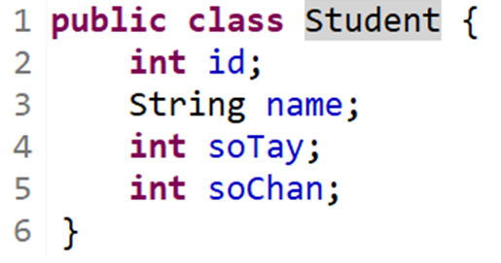
Default Constructor

Slide 8
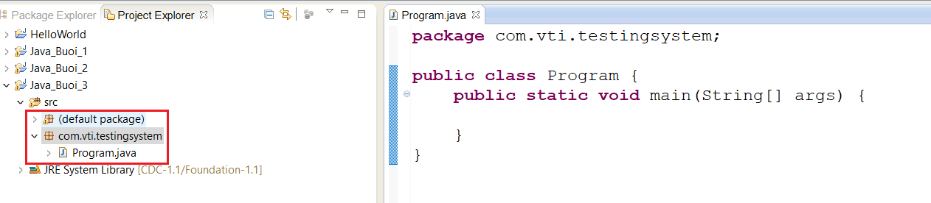
Package

Slide 9
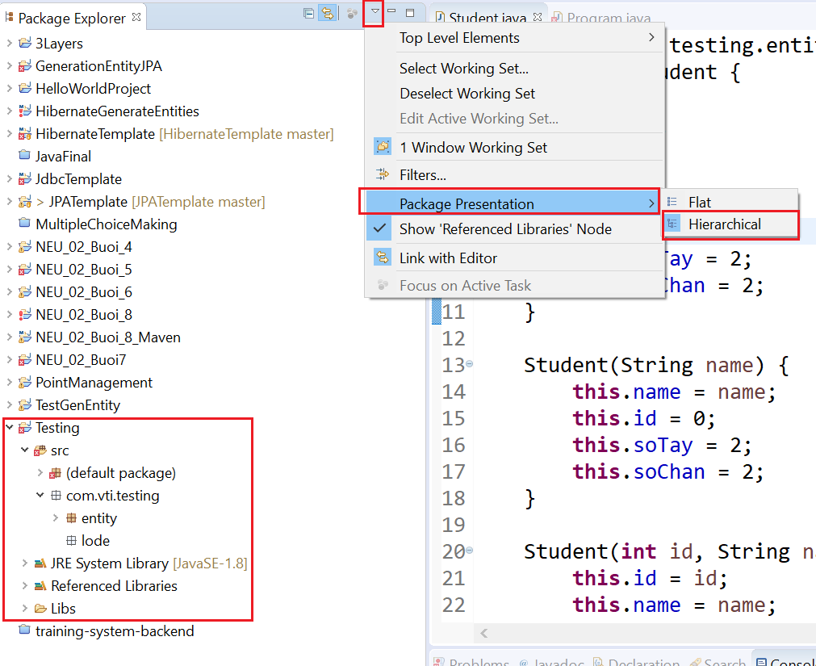
Package

Slide 10
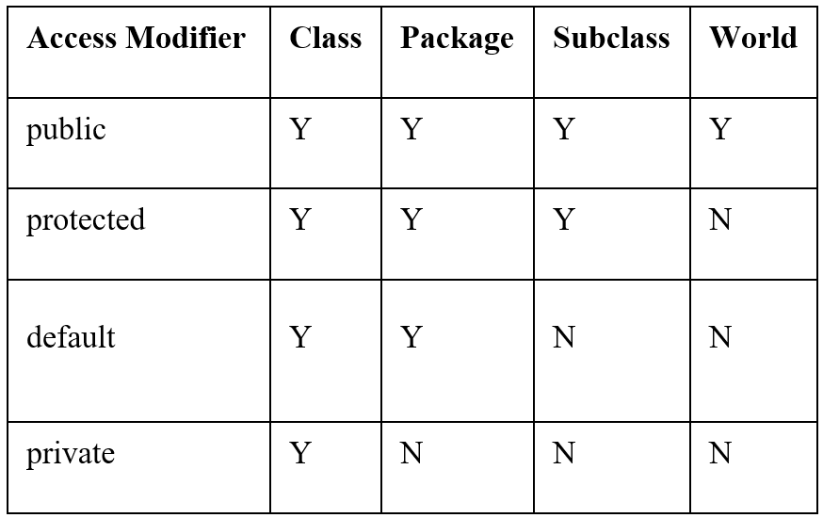
Access Modifier
Class, constructor, method, property

Slide 11
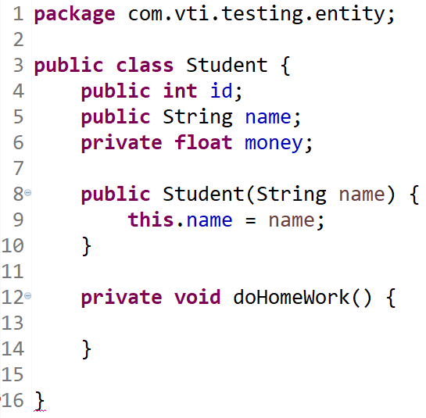
Example

Slide 12
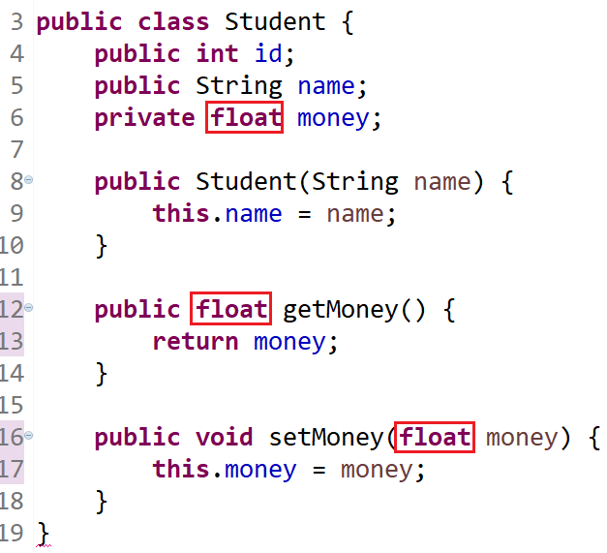
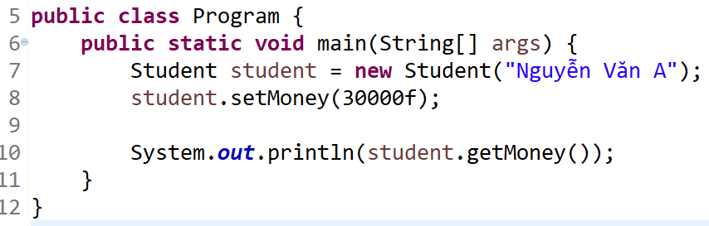
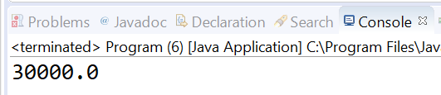
Getter & Setter

Slide 13
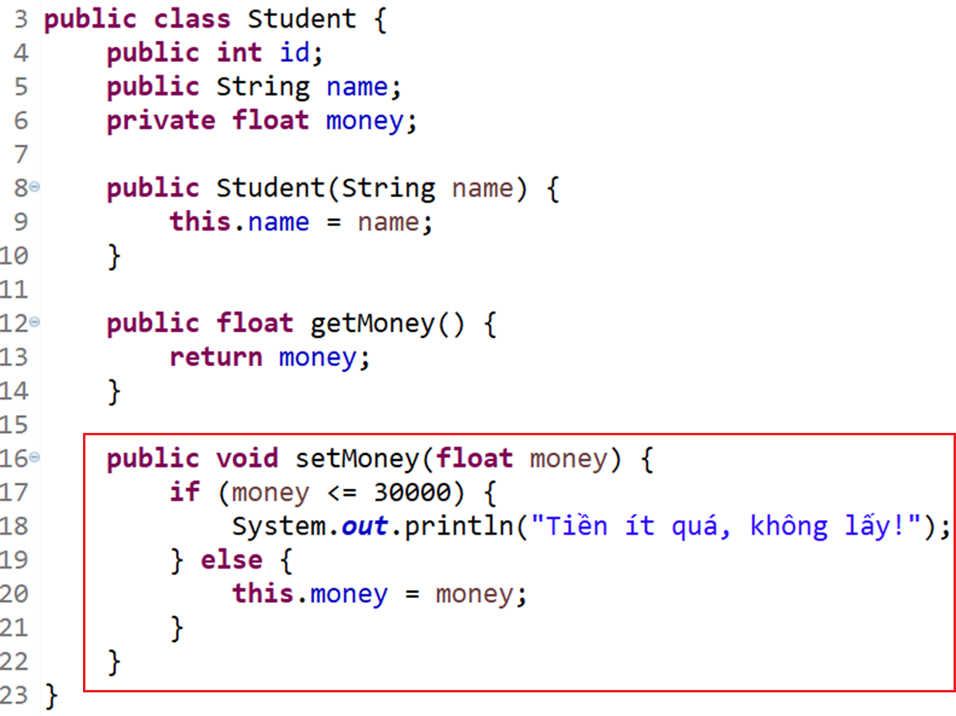
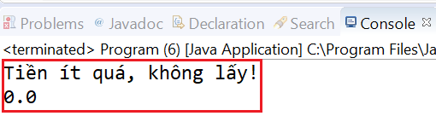
Getter & Setter

Slide 14
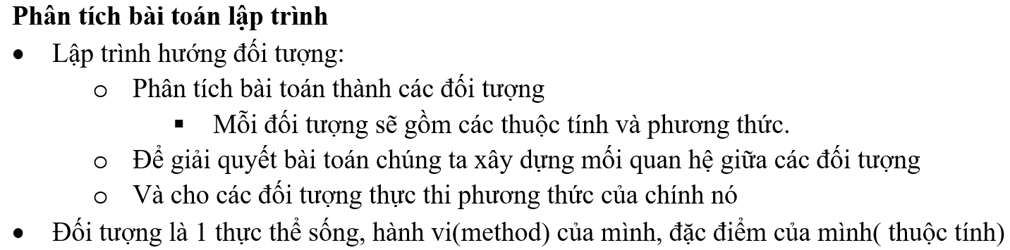
OOP

Slide 15
4 Properties
Encapsulation (đóng gói)
Inheritance (kế thừa)
Abstraction (trìu tượng)
Polymorphism (tính đa hình)

Slide 16
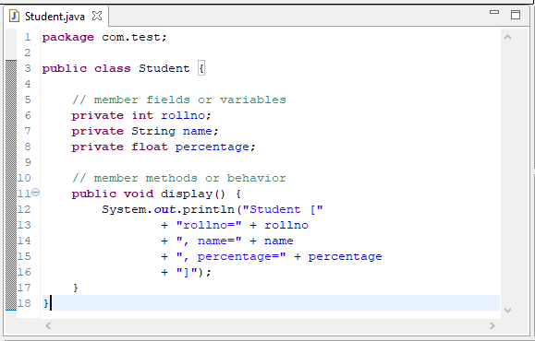
Encapsulation
Access modifier: Private
Getter / Setter

Slide 17
Inheritance
Keyword: Extend
Multi level inheritance
Direct superclass (1 level)
Indirect superclass (2 level)
Single inheritance

Slide 18
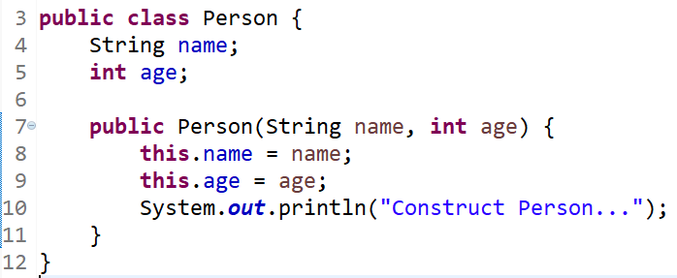
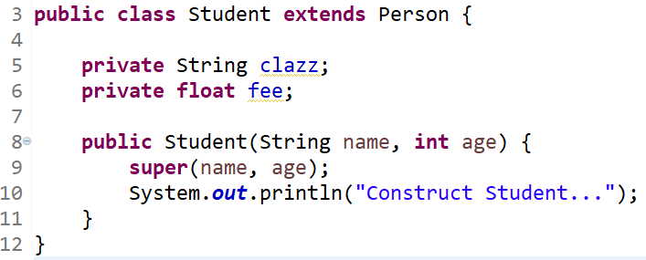
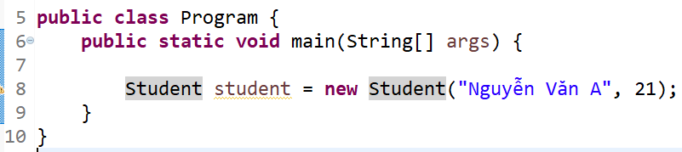
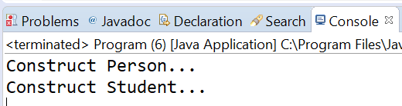
Constructor Inheritance
Init constructor from child to parent

Slide 19
Abstraction
Abstract class
Interface

Slide 20
Abstract class
Is object but not completed yet
abstract class, abstract method

Slide 21
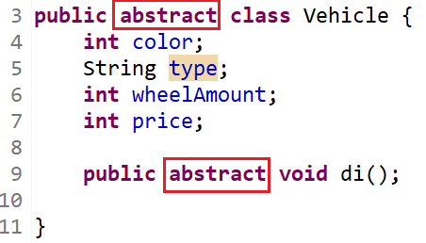
Example

Slide 22
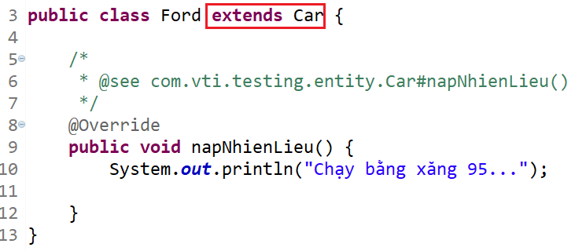
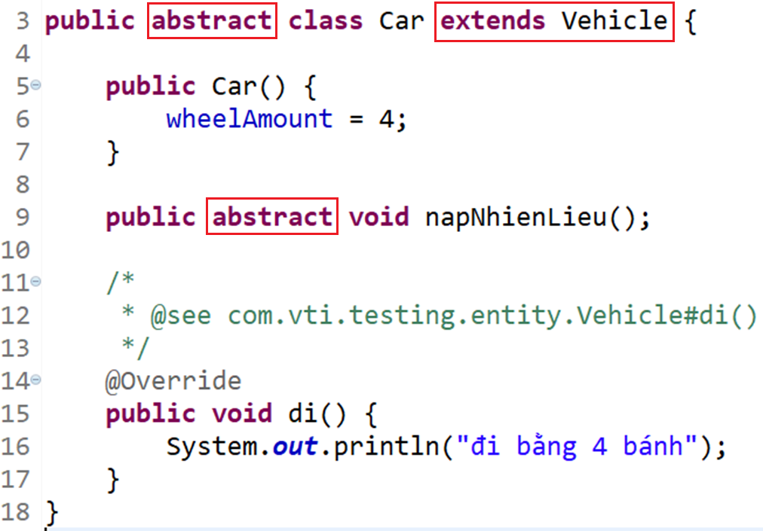
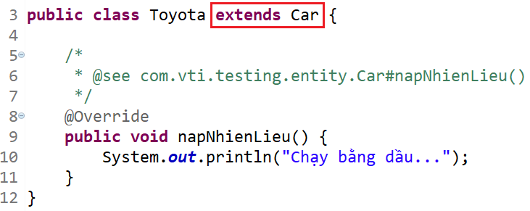
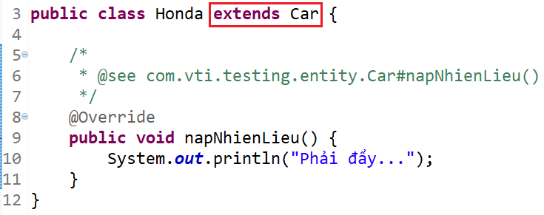
Example

Slide 23
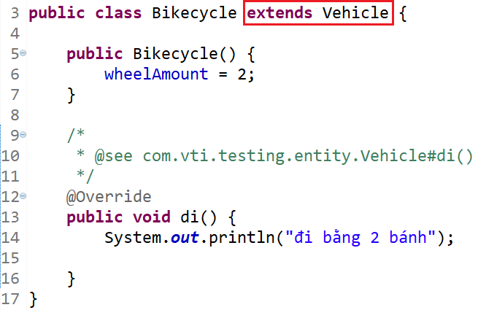
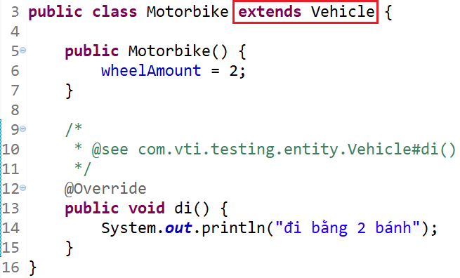
Example

Slide 24
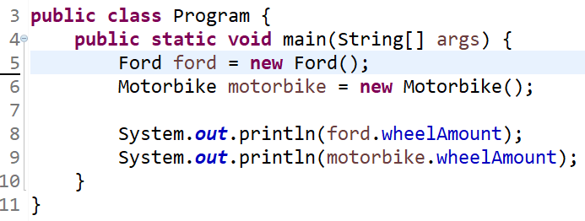
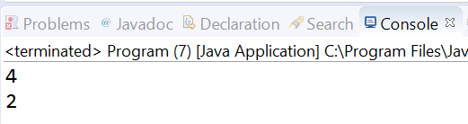
Example

Slide 25
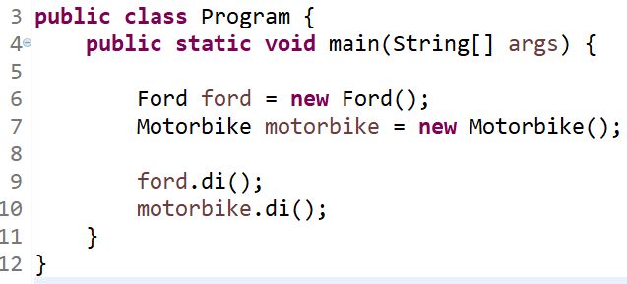
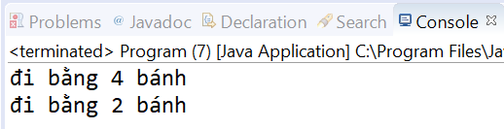
Example

Slide 26
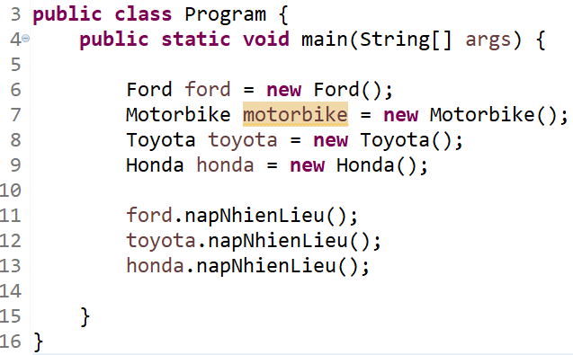
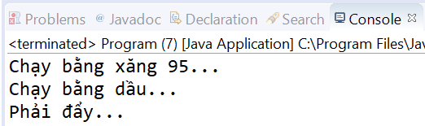
Example

Slide 27
Assignments 1

Slide 28
Assignments 2
Assignment for Testing System

Slide 29
Q & A
Copyright © VTI Academy All Rights Reserved

